Slide 1
More Ideas for the Independent Study Fall 2013
Wencan Luo
09/06/2013

Slide 2
Outlines
I: Modeling Conflict in Multi-part Dialogues
II: Graph Modeling of Team Cooperation
III: Picture Your Speech
IV: Comparison of Word Clustering Algorithms on Semantic Role Labeling

Slide 3
I: Modeling Conflict in Multi-part Dialogues
Examples

Slide 4
The Corpus
The Pitt Eng
1403 of 45,766 are annotated as Conflict
1144 high, 192 low, others are unknown
Challenges
Semantic Involved
“you are insane”
Context Dependent
“No” in example 2

Slide 5
II: Graph Modeling of Team Cooperation
Motivation I
5 Different Types of Leadership
Laissez-Faire
Autocratic
Participative
Transactional
Transformational
Might can be mapped to different graph structures
Notes:
http://smallbusiness.chron.com/5-different-types-leadership-styles-17584.html

Slide 6
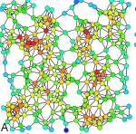
Motivation II: Graph Theory
Centrality
Importance of a vertex
Fairness
Whether users are receiving a fair share of resources

Slide 7
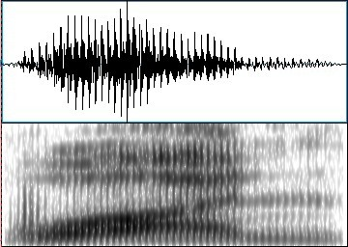
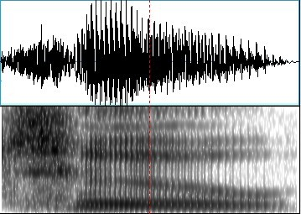
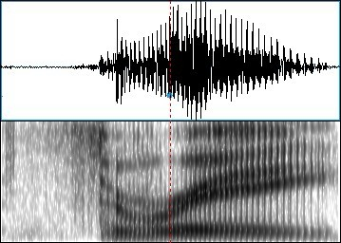
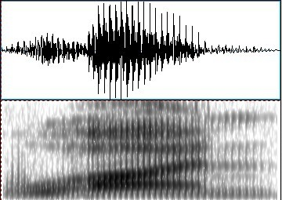
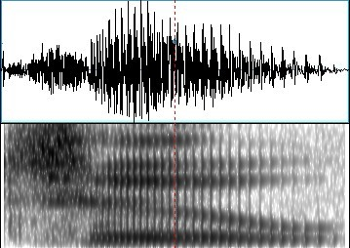
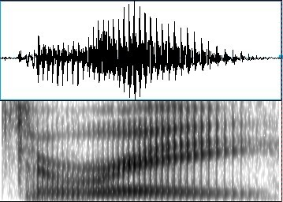
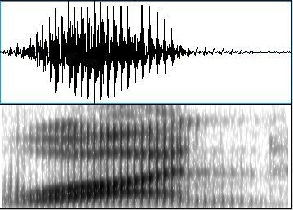
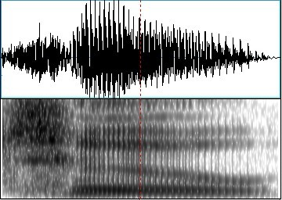
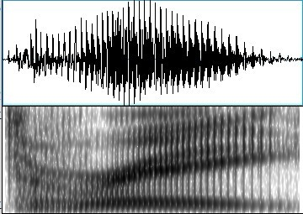
III: Picture Your Speech
Recognize the speech from its picture
One
Two
Three
Notes:
speech spectrum, spectrogram

Slide 8
Motivation
Translate 1-d speech to 2-d image
Deep learning on pictures is better
Similar spectrogram for same speech, but different spectrogram for different speech

Slide 9
IV: Comparison of Word Clustering Algorithms on Semantic Role Labeling
Group similar word together
Out-of-Vocabulary (OOV) Problem
Sparsity Problem
Biology support: people have semantic memory
Question
How good are they?
Notes:
Memory is organized around personal experiences or episodes rather than around abstract semantic categories

Slide 10
Word Clustering Methods
Brown et al., 1992
LSA
LDA
Deep Learning
Others
Maas et al., 2012

Slide 11
Extrinsic Task
Semantic Role Labeling
CoNLL-2004 and CoNLL-2005 Shared Tasks
Data
PropBank

